Slide 1

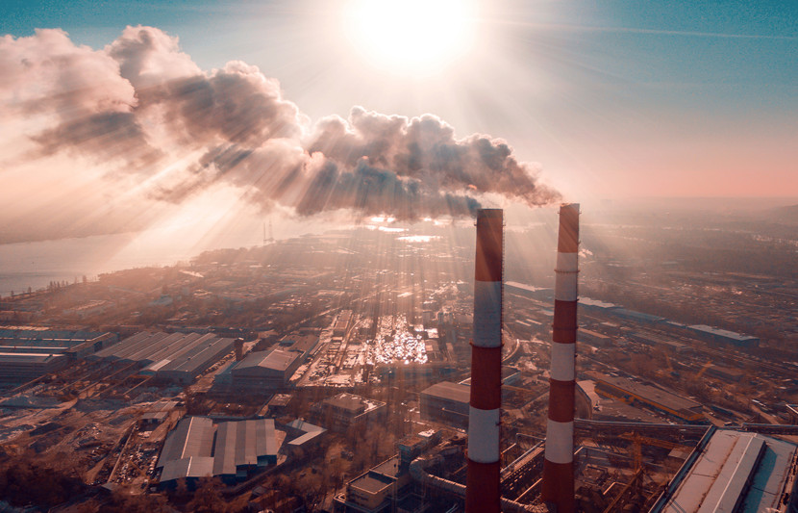
Analysis of Air Quality Index (AQI) in India
By- Abhishek Aggarwal
Notes:
I am presenting Analysis on Air Quality Index in india

Slide 2

Research Question
Question: How can we predict the Air Quality Index (AQI) in different states of India using machine learning?
Why It Matters: AQI is important part as it influence's public health, policymaking, and environmental protection. Predicting it can help in taking more proactive measures to improve quality of life for the people.
Notes:
Stick to the written things

Slide 3
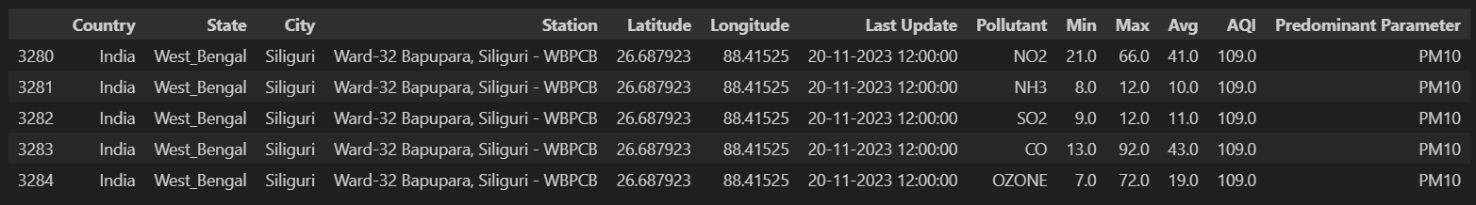
Introduction to Dataset
Data Source: Kaggle
Key Features: Pollutant levels (PM2.5, PM10, SO2, NO2, OZONE, CO, NH3)
AQI values Geographic information (State, City, Station)Date and Time of measurements
Notes:
Explain colums

Slide 4
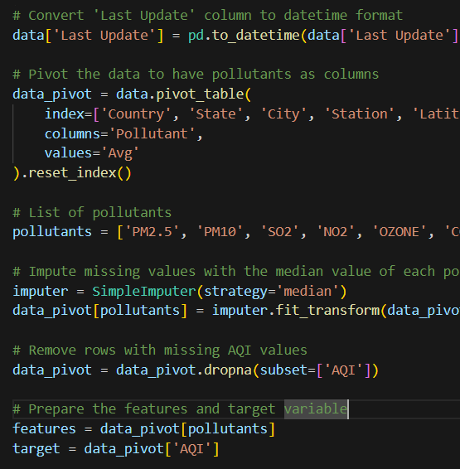
Data Preparation
Handling Missing Values: Used SimpleImputer to fill in missing pollutant values.
Data Transformation: Pivoted the data to have pollutants as columns, making analysis easier.
Feature and Target Preparation: Prepared the features (pollutants) and target variable (AQI).
Data Splitting: Split the dataset into training and testing sets using train_test_split.
Notes:
I changed some data to have pollutants as columns so the analysis can be easily be done

Slide 5
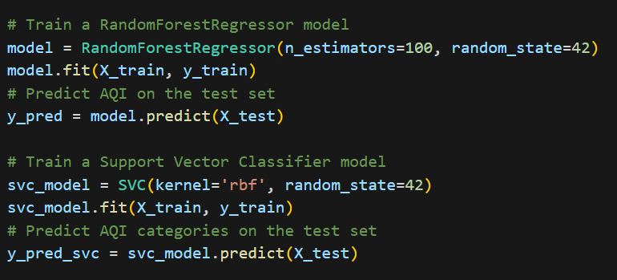
Machine Learning Techniques
I used both Support Vector Machine and Random Forest Regressor techniques. But I focused on Random Forest Regressor because of better results
Classification: Used to categorize AQI levels into predefined categories.
Regressor: Used to group cities based on similar pollution profiles.
Notes:
I focused on random forest regressor model as givine me more accuracy in my results

Slide 6
Description of Models
 | Random Forest Regressor: | Support Vector Machine
Accuracy | 99.43% | 0.00%
R² | 0.99 | 0.85
Mean Squared Error | 54.81 | 1393.71
I Choose, Random Forest Regressor as it has given me the most reliable results for predicting AQI values.
Notes:
Talk about the results

Slide 7
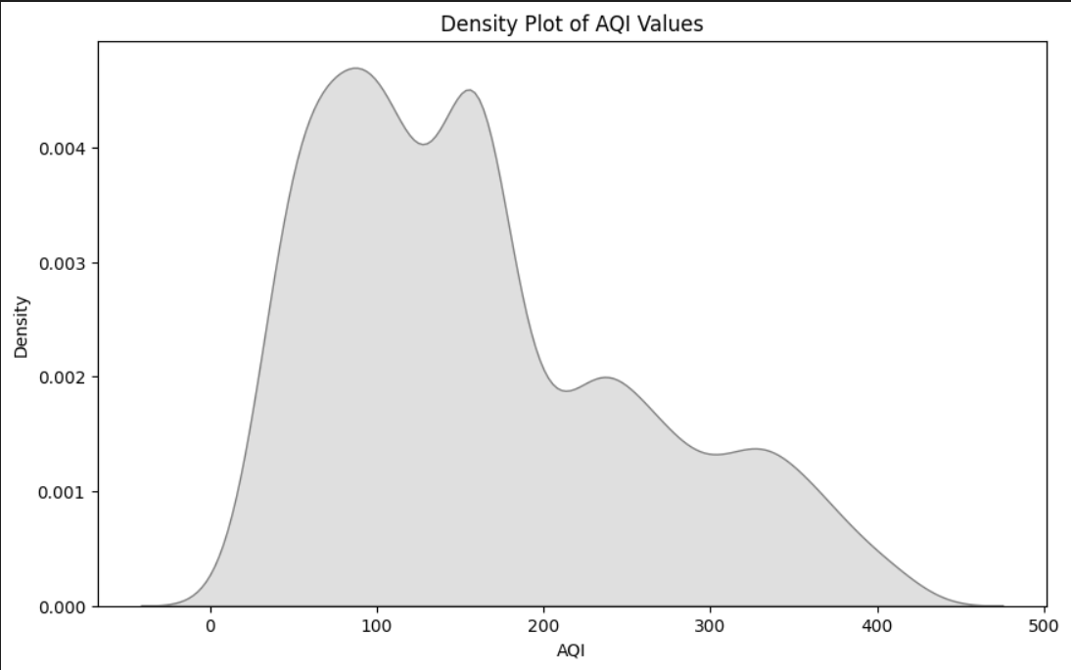
Visualization
Correlation Heatmap: Shows relationships between pollutants and AQI.
Scatter Plot: Visualizes predicted vs actual AQI values.
Geographical Distribution: Map showing AQI levels at various monitoring stations.
Bar Chart: Stacked bar chart of predominant pollutants in different states.
Notes:
charts

Slide 8
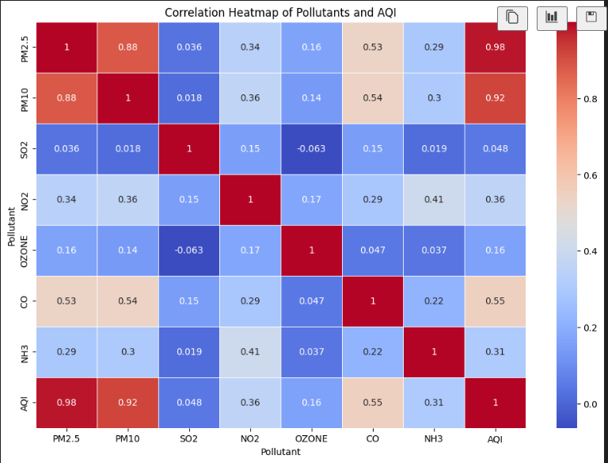
Correlation Heatmap
Shows relationships between pollutants and AQI.

Slide 9
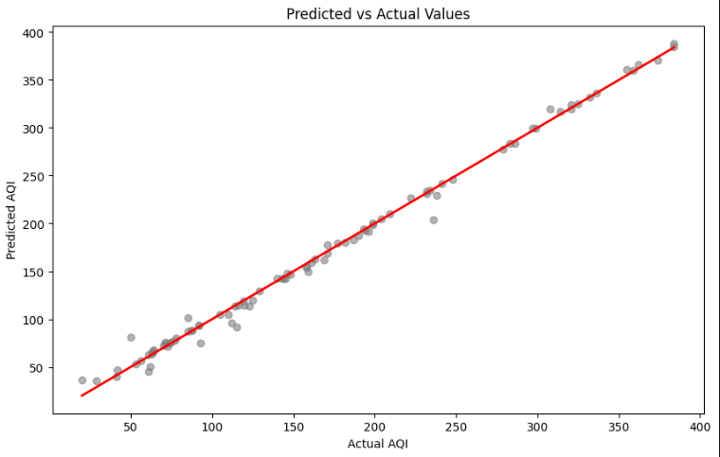
Scatter Plot
Visualizes predicted vs actual AQI values.

Slide 10
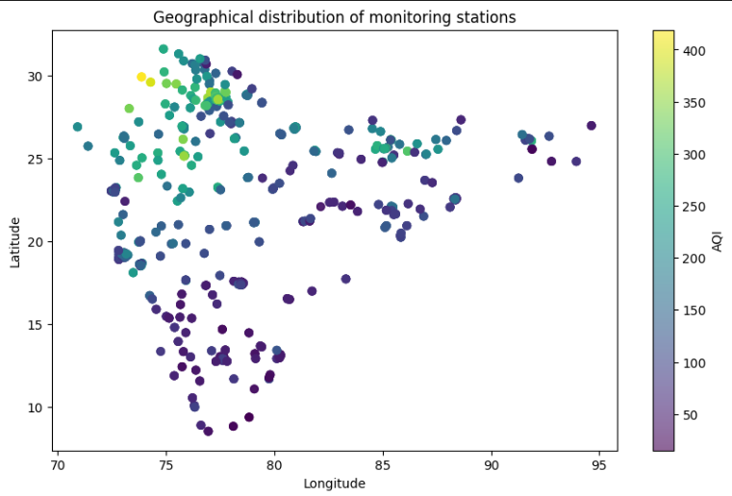
Geographical Distribution
Map showing AQI levels at various monitoring stations.

Slide 11
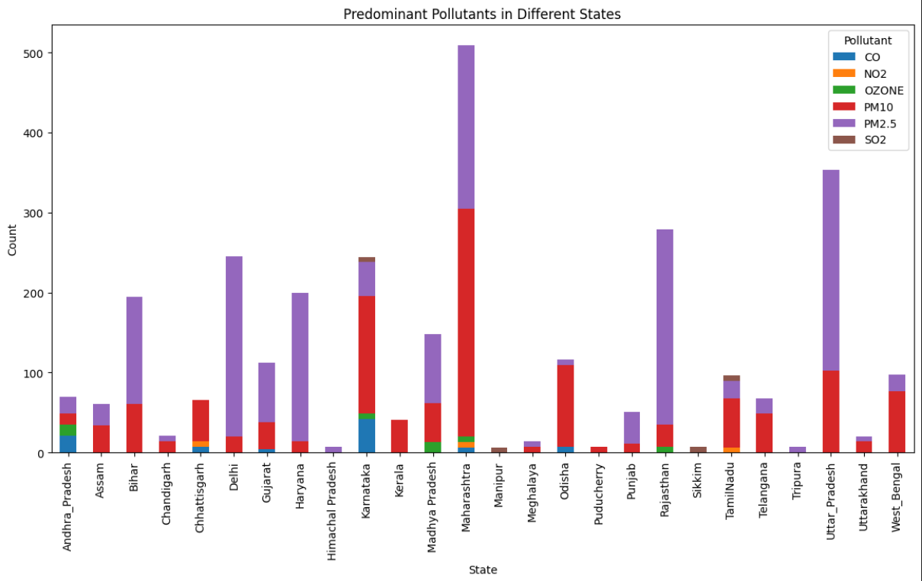
Bar Chart
Stacked bar chart of predominant pollutants in different states.

Slide 12
Conclusion and Insights
I have learned a lot about the challenges of utilizing machine learning techniques to predict air quality thanks to this work. I discovered the RandomForestRegressor's advantages in managing actual environmental data and producing precise AQI forecasts by experimenting with it. I also realized the significance of data preparation and pre-processing.

Slide 13
Limitations
Data Limitations:
Missing values and data quality issues.
Limited geographic scope.
Incomplete temporal coverage.
Method Limitations:
In order to produce more accurate results, the models first make assumptions about the relationships between variables, which may not accurately reflect the complexity of the real world

Slide 14

Thank you
Abhishek Aggarwal​
aa1587@exeter.ac.uk

